Slide 1
DSCI 5360.006 – DATA VISUALIZATION FOR ANALYTICS GROUP 4
Understanding Road Safety Trends: An Analysis of Road Accidents From January 2021 To December 2022
Team Members
Puja Madhav
Taruni Madugula
Saadana Shyam Sunder
Deepthi Sree Boonapalli
Hari Charan Reddy Karra
Kanaka Sri Brahmini Bandla

Slide 2
Dataset Description: Source:Kaggle This dataset Comprising a total of 300,000 records, provides a simulated collection of records detailing road accidents that purportedly occurred between January 2021 and December 2022. Place :United Kingdom Our dataset is both Categorical and numerical variables
Variables of Interest: Notable variables included in the dataset encompass a wide array of factors pertinent to road accidents, such as:
Accident_Index: A unique identifier for each accident record.
Accident Date: The date on which the accident occurred (format: DD/MM/YYYY).
Day_of_Week: The day of the week when the accident took place.
Accident_Severity: Indicates the severity of the accident
fatal accident is an accident in which at least one person is fatally injured;
serious accident is one in which at least one person is seriously injured, but no-one suffers a fatal injury;
Slight accident is one in which at least one person suffers slight injuries, but no-one is seriously injured, or fatally injured.
Fetal- when any maternal death is involved
Latitude: The geographic latitude of the accident location.
Longitude: The geographic longitude of the accident location.
Local_Authority_(District): The local authority district where the accident occurred.
Carriageway_Hazards: Describes any hazards present on the carriageway at the time of the accident (e.g., "None").
Police_Force: The police force that handled the accident.
Time: The time of day when the accident happened (format: HH:MM).
Urban_or_Rural_Area: Indicates whether the accident occurred in an urban or rural area.

Slide 3
Junction_Control : Describes the type of junction control at the accident location (e.g., "Give way or uncontrolled").
1. Give way or uncontrolled
2. Auto traffic signal
3. Data missing or out of range
4. Authorised person
5. Not at junction or within 20 metres
6. Stop sign
Junction_Detail: Provides additional details about the junction where the accident occurred (e.g.,
1. Crossroads
2. Mini-roundabout
3.More than 4 arms (not roundabout)
4.Not at junction or within 20 metres
5. Other junction
6. Private drive or entrance
7. Roundabout
8. Slip road
9. T or staggered junction
Light_Conditions: Describes the lighting conditions at the time of the accident
1. Darkness - lighting unknown
2. Darkness - lights lit
3. Darkness - lights unlit
4. Darkness - no lighting
5. Daylightaccident (e.g., "Dry").
Road_Surface_Conditions: Describes the surface conditions of the road at the time of the day
1. Null
2. Dry
3. Flood over 3cm. Deep
4. Frost or ice
5. Snow
6. Wet or damp

Slide 4
Road_Type: Specifies the type of road where the accident occurred
1. Null
2. Dual carriageway
3. One way street
4. Roundabout
5. Single carriageway
6. Slip road
Weather_Conditions: Describes the weather conditions at the time of the accident (e.g., "Fine no high winds").
Null
Fine + high winds
Fine no high winds
Fog or mist
Other
Raining + high winds
Raining no high winds
Snowing + high winds
Snowing no high winds
Vehicle_Type: Specifies the type of vehicle involved in the accident (e.g., "Car," "Taxi/Private hire car").

Slide 5

Measures:
Number_of_Casualties: The total number of casualties involved in the accident.
Number_of_Vehicles: The total number of vehicles involved in the accident.
Speed_limit: The speed limit applicable to the road where the accident occurred.

Slide 6
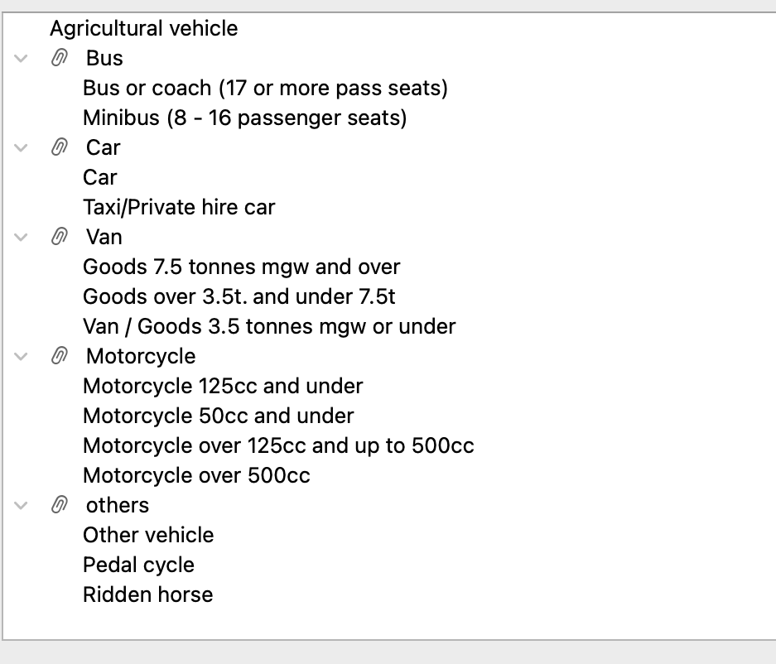
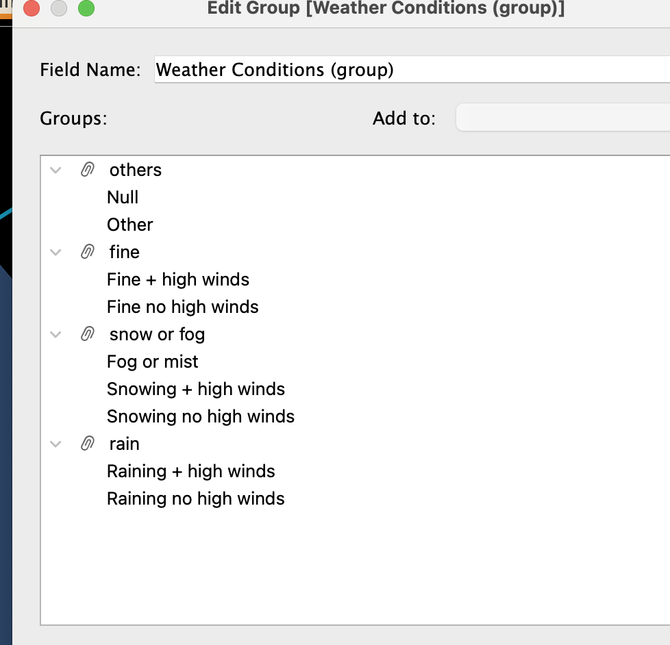
Data Preprocessing for Enhanced Analysis
Null Value Treatment: Initiated by meticulously cleansing the dataset, we removed all instances of null values to ensure the integrity and accuracy of subsequent analyses.
Variable Grouping: We strategically grouped related variables to streamline the dataset. For instance, weather conditions, road types, Vehicle Type were categorized together for more coherent analysis.

Slide 7
Calculated Field Development: To deepen our analytical capability, we crafted calculated fields, allowing us to derive new variables that enrich our charts with additional layers of information.
YOY Accidents
([CY Accidents]-[PY Accidents ])/[PY Accidents ]
Temporal Segmentation: Leveraging the Datepart function, we segmented time data into discrete hourly blocks, as well as classified them into broader categories of Day and Night. This enabled a more granular investigation of temporal patterns.
IF DATEPART('hour', [Time]) < 12 THEN 'Morning'
ELSE 'Evening'
END
Interactive Filters and Parameters: Each chart was equipped with custom filters and parameters, providing a dynamic and interactive user experience that enables tailored views and insights based on user-defined criteria.
Current year parameter
SUM(IF YEAR([Accident Date])=[Current Year]
THEN [Number of Casualties] END)
Through these meticulous preprocessing steps, our dataset is now primed for robust and insightful exploration, ready to uncover the subtleties hidden within the traffic accident data.

Slide 8
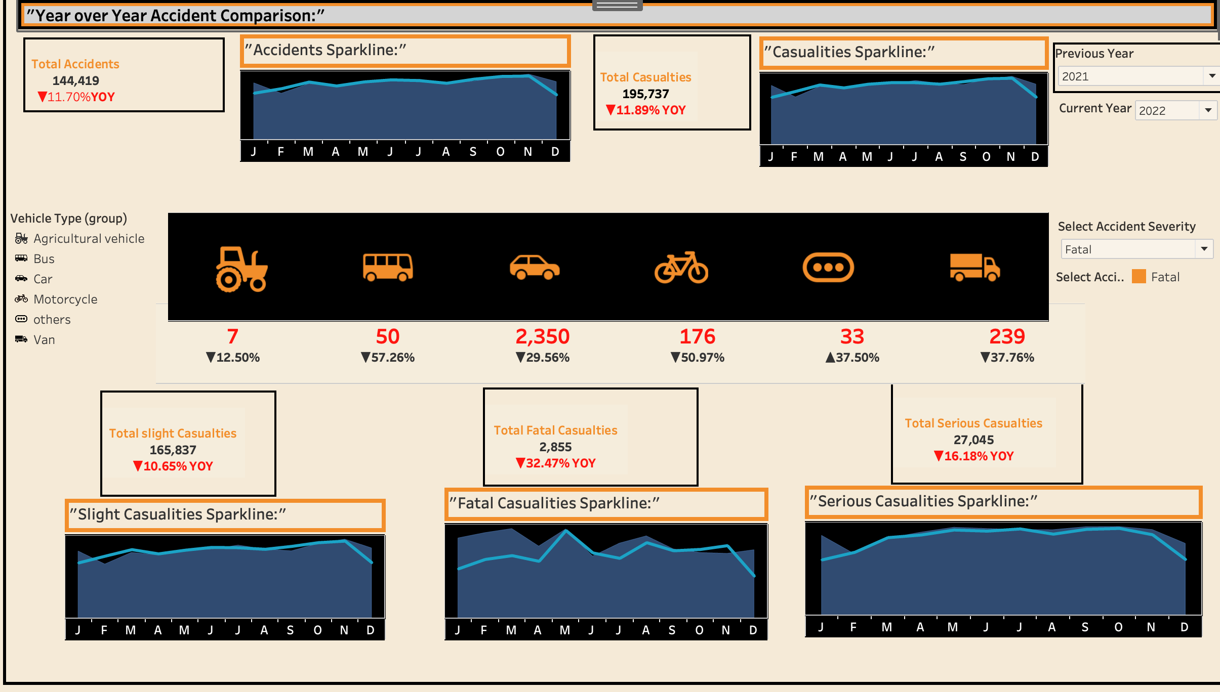
Dashboard 1:"Year over Year Accident Comparison:"

Slide 9
Dashboard 1:"Year over Year Accident Comparison:"
Questions that can be answered from this dashboard:
How have total accidents and casualties changed compared to the previous year?
The previous year 222146 and current year 195737
What are the trends in accidents and casualties throughout the current year?
The trend is decreasing
Which types of vehicles are most involved in accidents?
The car has more number of accidents
Has there been a significant change in the number of accidents involving specific types of vehicles?
The car has more number of accidents evern if the severity level changes followed by truck
Are certain months more dangerous in terms of fatal or serious casualties?
Fatal-May,Serious-June and July
Dashboard Overview:
The dashboard is a visual representation of road traffic accidents and their outcomes over the course of a year, with a comparison to the previous year's data.
Dashboard Motivation: It appears to be designed for stakeholders interested in road safety, such as traffic management authorities, policy makers, or public safety organizations.

Slide 10
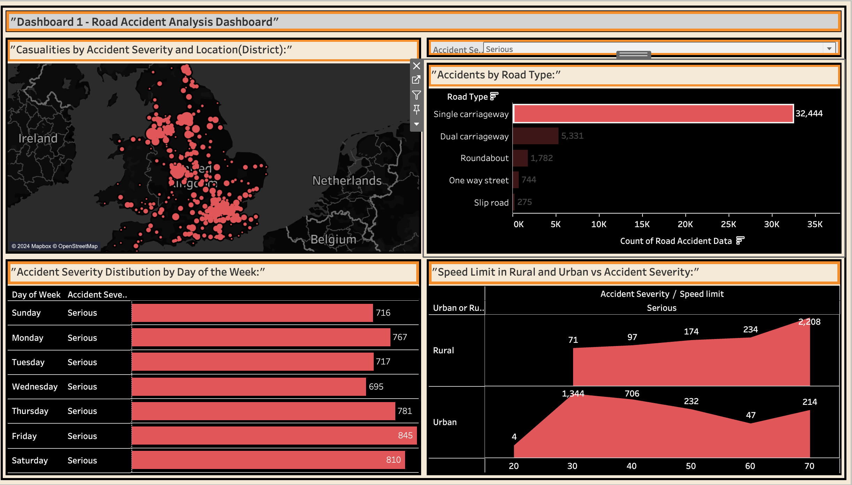
Dashboard2:”Road Accident Analysis Dashboard based on Roadtype"

Slide 11
Dashboard2:”Road Accident Analysis Dashboard based on Roadtype"
Questions that can be answered from this dashboard:
Where do most accidents occur geographically?
Fatal-West oxfordshire,stevage and bexely
Slight-leeds and south east part of uk
Which road types have the most accidents?
Slight-Single Carriage way
On which days of the week do most accidents happen according to severity level?
Slight-Friday,fatal-Saturday,serious-friday
How does accident severity correlate with the speed limit in rural versus urban areas?
Slight -30
It also depend upon roadtype
This dashboard is designed to provide a comprehensive overview of road accidents, focusing on the severity and location of incidents, as well as factors like road type and speed limits that might influence accident rates. It could be particularly useful for transportation planners, policymakers, and public safety officials who need to identify high-risk areas and factors to target for interventions.

Slide 12
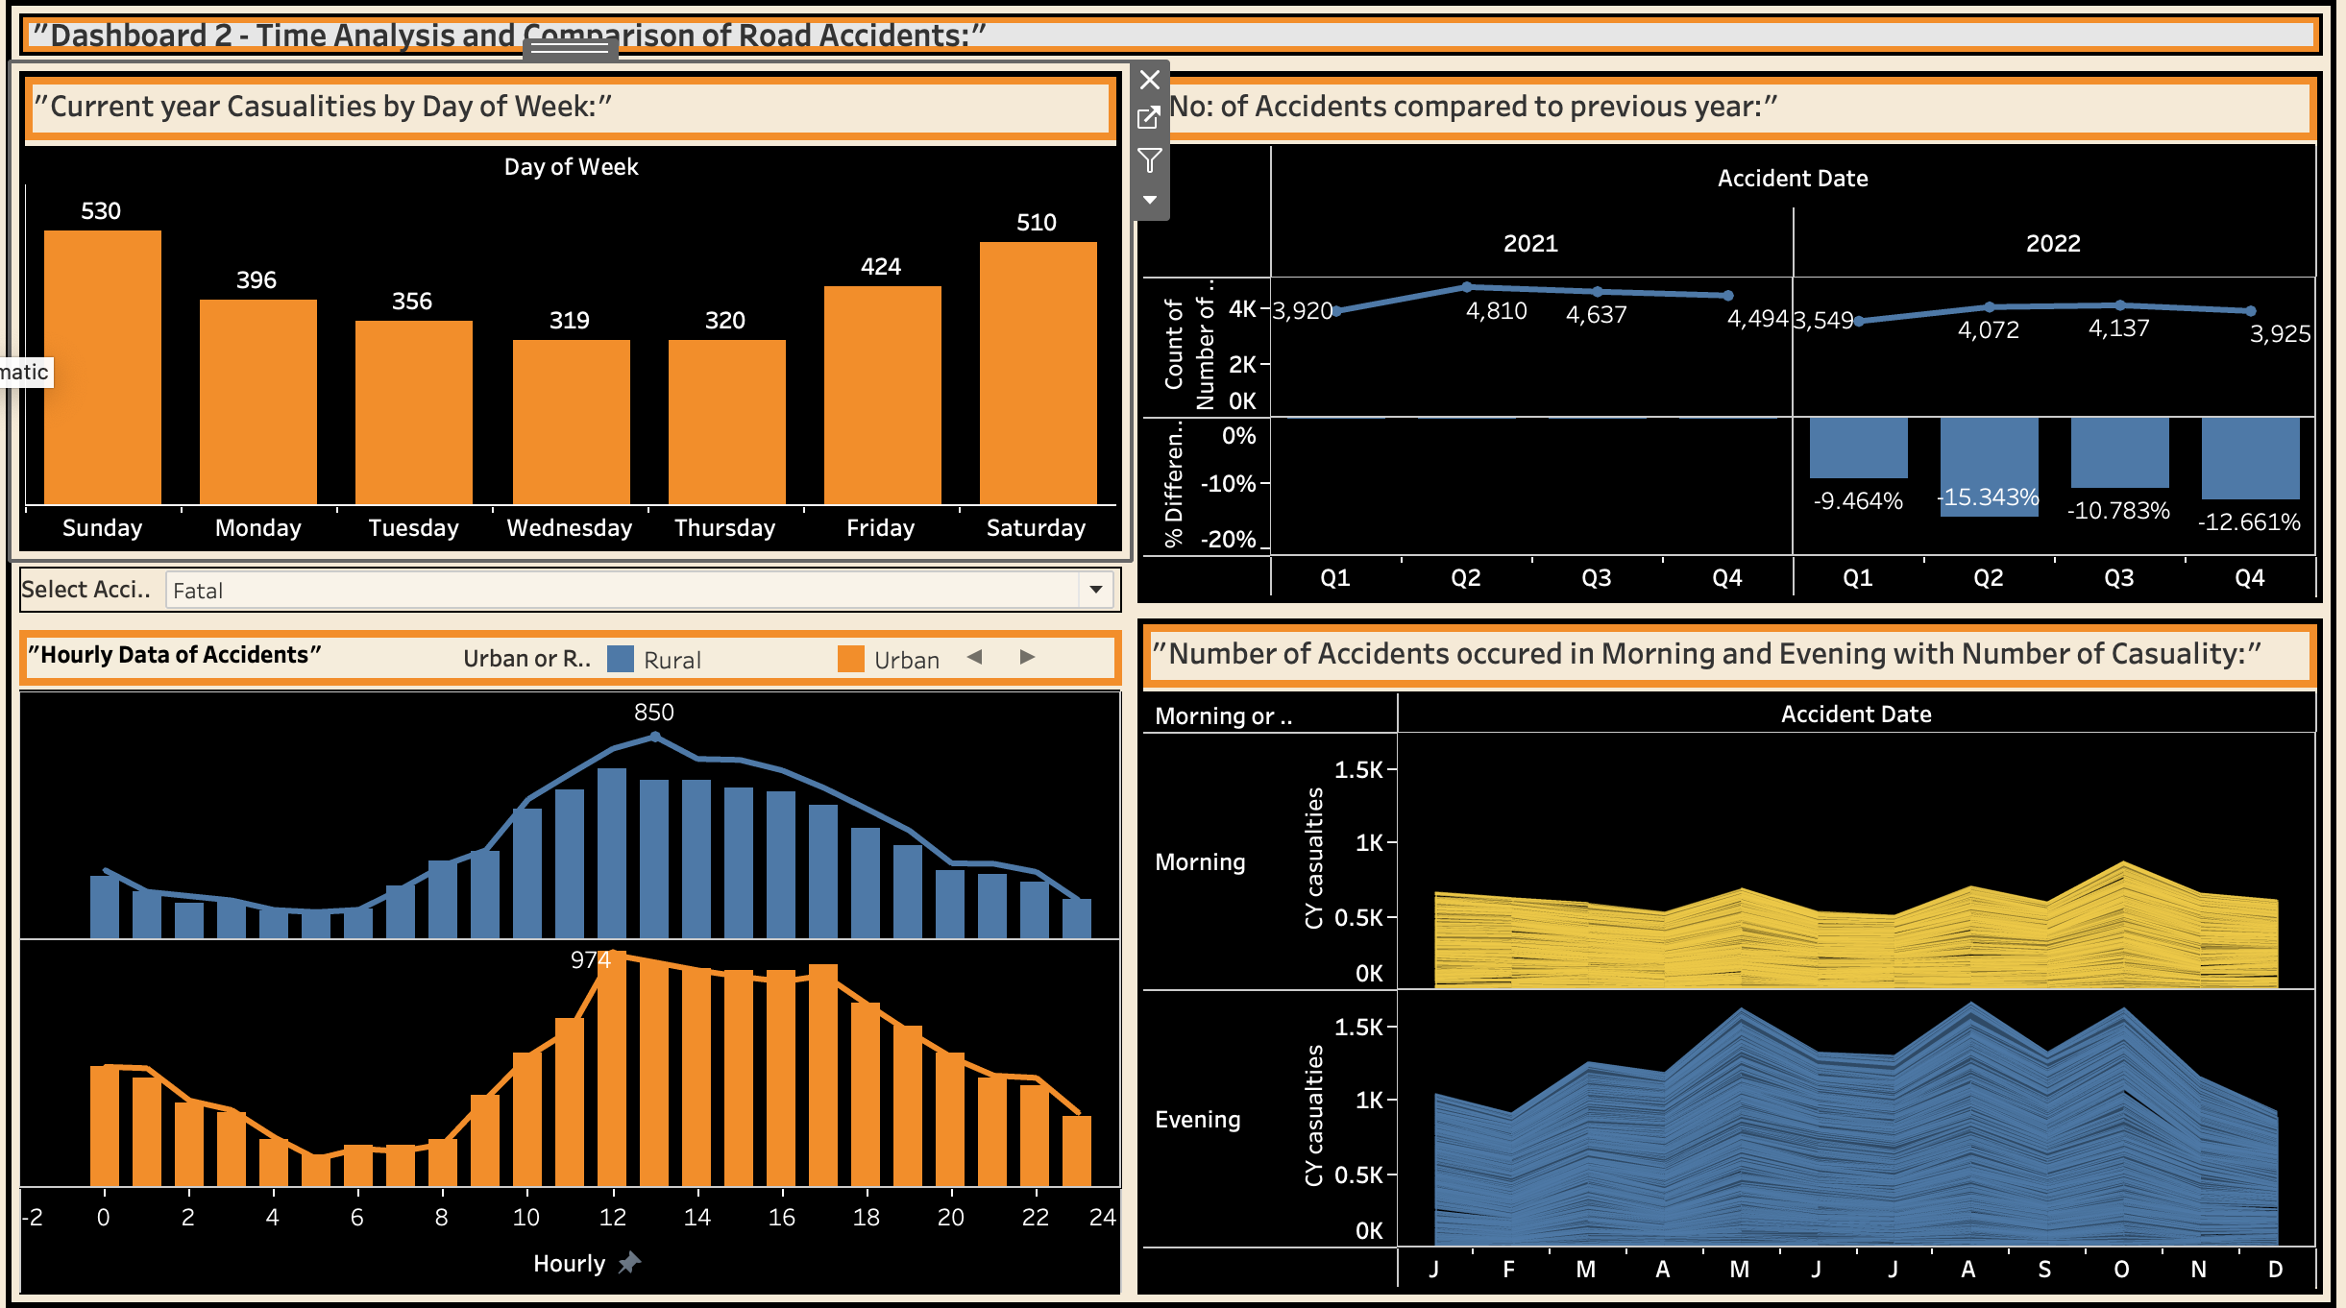
"Dashboard 3- Time Analysis and Comparison of Road Accidents:"

Slide 13
"Dashboard 3- Time Analysis and Comparison of Road Accidents:"
Questions that can be answered from this dashboard:
What is the distribution of casualties by day of the week?
Friday -all,fatal-Sunday,serious and slight -friday
How has the number of accidents changed compared to the previous year?
It has decreased
What are the peak times for accidents during the day in urban and rural areas?
Rural-12-2pm
Urban-12pm-5pm
Are there differences in the number of accidents and associated casualties in the morning compared to the evening?
Evening has most number of casualities
The dashboard is a specialized tool for time analysis and comparison of road accidents. It could be used by road safety analysts, urban planners, and public health officials to understand temporal patterns in road accidents and inform strategies for intervention. It helps to pinpoint when and where road safety measures might be most needed and to track the progress of those measures over time.

Slide 14
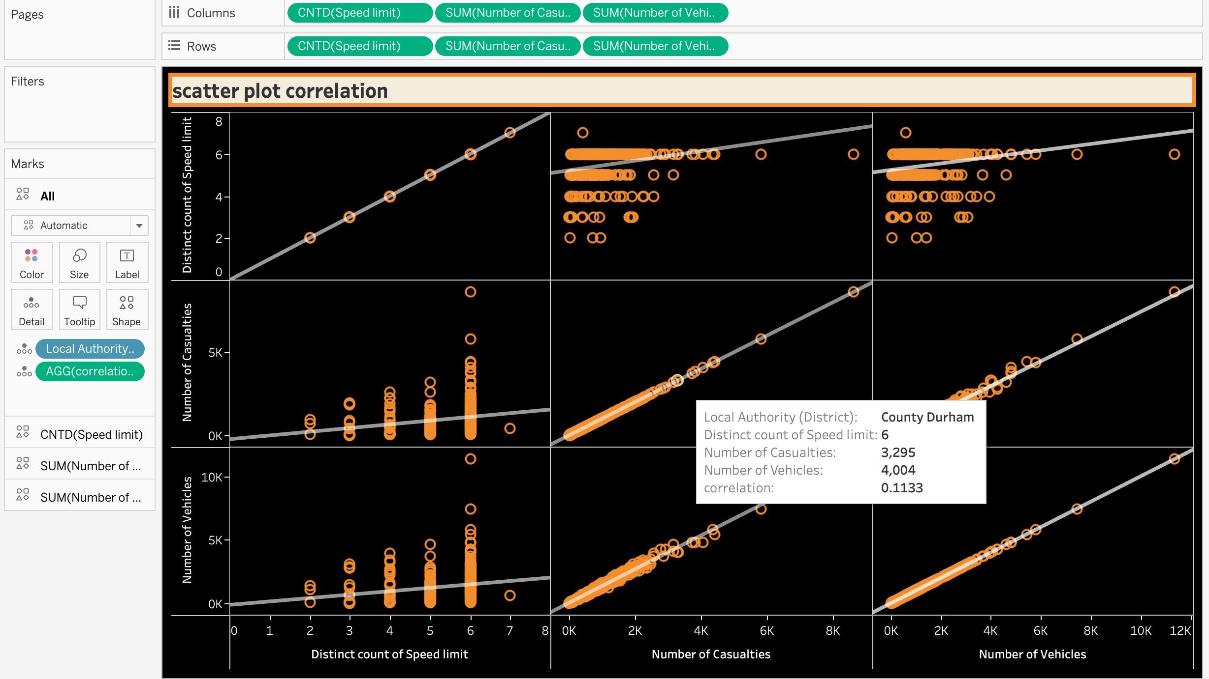
Exploring the Correlation: Speed Limits, Casualties, and Vehicles in Road Accidents

Slide 15
Exploring the Correlation: Speed Limits, Casualties, and Vehicles in Road Accidents
- Is there a relationship between the complexity of speed limits and accident severity?
- The plots suggest that a higher diversity of speed limits within a district is associated with both an increase in the number of casualties and the number of vehicles involved in accidents.
- Are districts with more diverse speed regulations experiencing more accidents?
- While the plots show a correlation, causation cannot be determined from correlation alone. However, it does raise questions about whether more complex speed limit landscapes contribute to higher accident rates.
- Does the number of vehicles involved in accidents correlate with the number of casualties?
- Yes, the direct relationship shown in the scatter plot supports the notion that more vehicles involved in accidents usually mean more casualties.

Slide 16
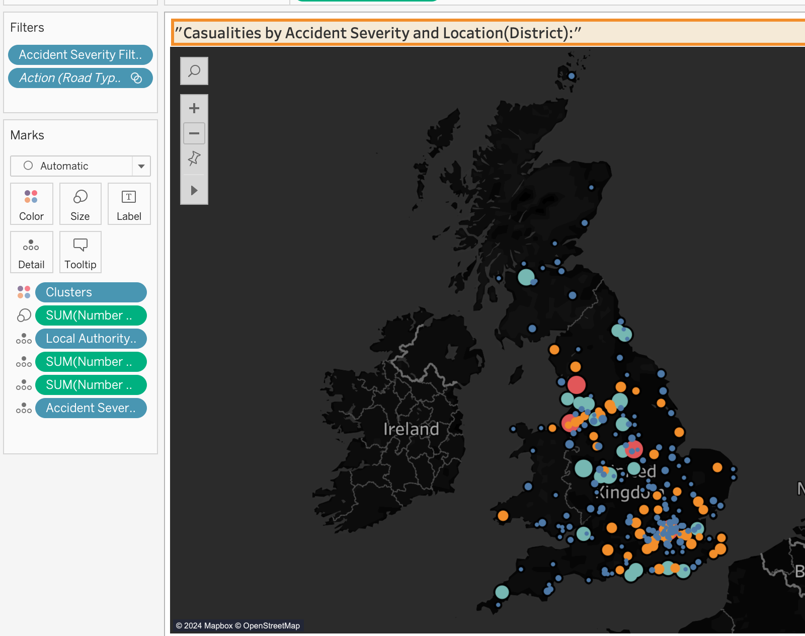
Accident Clustering by District: Exploring Severity, Frequency, and Variance
Which districts have the highest severity of accidents?
By looking at the color-coding and size of the dots on the map, we can identify areas with a higher severity of accidents.
Are accidents evenly distributed across the region?
The visualization indicates that accidents are not evenly distributed, with certain clusters showing a higher frequency or severity of accidents.
Do some districts have a higher number of vehicles involved in accidents?
Yes, the clusters with larger dot sizes suggest areas with a higher number of vehicles involved in accidents.
How distinct are the accident severities between clusters?
The significant ANOVA results indicate clear distinctions in the accident severities across clusters.

Slide 17
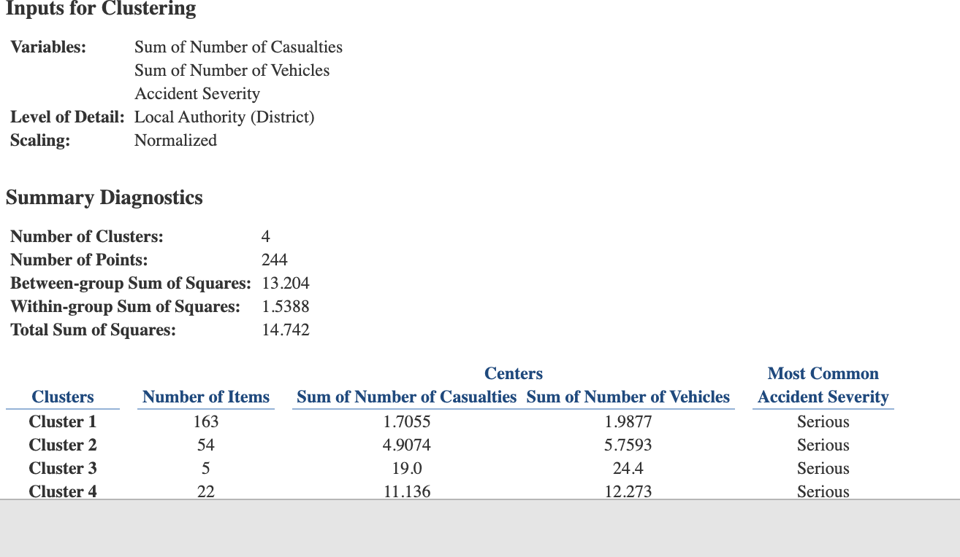
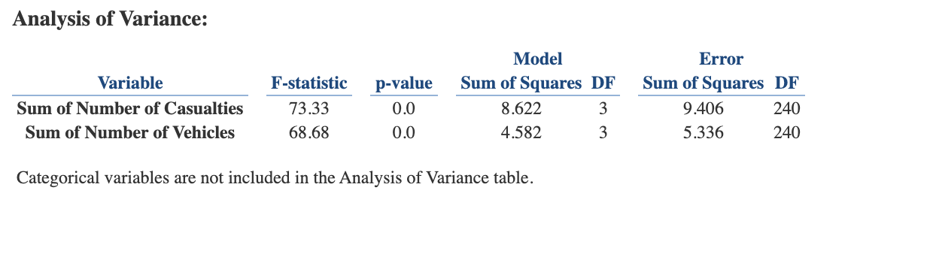
Inputs for Clustering:
Variables included are the sum of the number of casualties, the sum of the number of vehicles, and the accident severity.
Data has been normalized and is detailed by the local authority (district).
Summary Diagnostics:
There are 4 clusters created from 244 data points (locations).
The within-group sum of squares is low (1.5388), suggesting that the points within each cluster are close to their respective centroids.
The between-group sum of squares is substantially higher (13.204) relative to the within-group sum, indicating that the clusters are distinct from one another.
Clusters Information:
Cluster 1 has the most items (163 locations) but lower average casualties and vehicles involved.
Cluster 2 has fewer items (54 locations) but a higher average of casualties and vehicles, indicating more severe accidents.
Clusters 3 and 4 have very few items, with cluster 3 showing particularly high averages, likely indicating specific areas where severe accidents are less frequent but more impactful when they occur.
Analysis of Variance (ANOVA):
The F-statistic and associated p-value for both the number of casualties and the number of vehicles are significant (p-value = 0.0), suggesting that there is a statistically significant difference in the means of these variables across the four clusters.

Slide 18
Summary and Conclusions
Throughout our research, we have unearthed significant findings that shed light on road accident patterns and their underlying factors. Our analysis has provided valuable insights into various aspects of road safety, aiding in the formulation of informed strategies and interventions. Here are the key findings and implications of our research:
Temporal Trends: Time series analysis revealed notable temporal trends in road accidents, including seasonal variations and long-term changes. Understanding these patterns allows for targeted interventions during peak accident periods and facilitates the allocation of resources effectively.
Geographical Hotspots: By analyzing accident locations, we identified geographical hotspots with heightened accident rates. Targeting these areas with tailored interventions and infrastructure improvements can mitigate accident risks and enhance overall road safety.

Slide 19
Risk Factors: Factors such as weather conditions, road surface conditions, junction control types, and vehicle types significantly influence accident occurrence and severity. Addressing these risk factors through appropriate measures and interventions can help reduce accident rates and mitigate their impact.
Demographic Considerations: While demographic information such as age groups was not fully available, its inclusion is crucial for understanding age-specific risk factors and tailoring interventions accordingly. Future research should focus on comprehensive data collection to address this gap.

Slide 20
Reference
Elvik, R., Hoye, A., Vaa, T., & Sorensen, M. (2009). The handbook of road safety measures. Emerald Group Publishing.
Antoniou, C., Yannis, G., & Papadimitriou, E. (2017). Road safety in European countries: Trends, statistics, and national policies. Journal of Transportation Safety & Security, 9(3), 266-286.
Xie, Y., Liu, C., Wang, J., & Li, J. (2020). A data-driven approach for visualizing road traffic accidents using geographic information systems: A case study in China. Safety Science, 131, 104903.
Shi, H., Wang, J., Zhang, D., & Gong, P. (2021). Visualization of road traffic accidents using spatial clustering and time series analysis. International Journal of Geographical Information Science, 35(5), 947-971.
Wang, Y., Li, J., & Wang, J. (2021). Visualizing road traffic accidents using GIS: A case study in Shenzhen, China. Sustainability, 13(15), 833
World Health Organization (WHO). (2021). Road traffic injuries. Retrieved from https://www.who.int/news-room/fact-sheets/detail/road-traffic-injuries

Slide 21
Thank you

